Slide 1
Languages
Graduate Award Programme

Slide 2
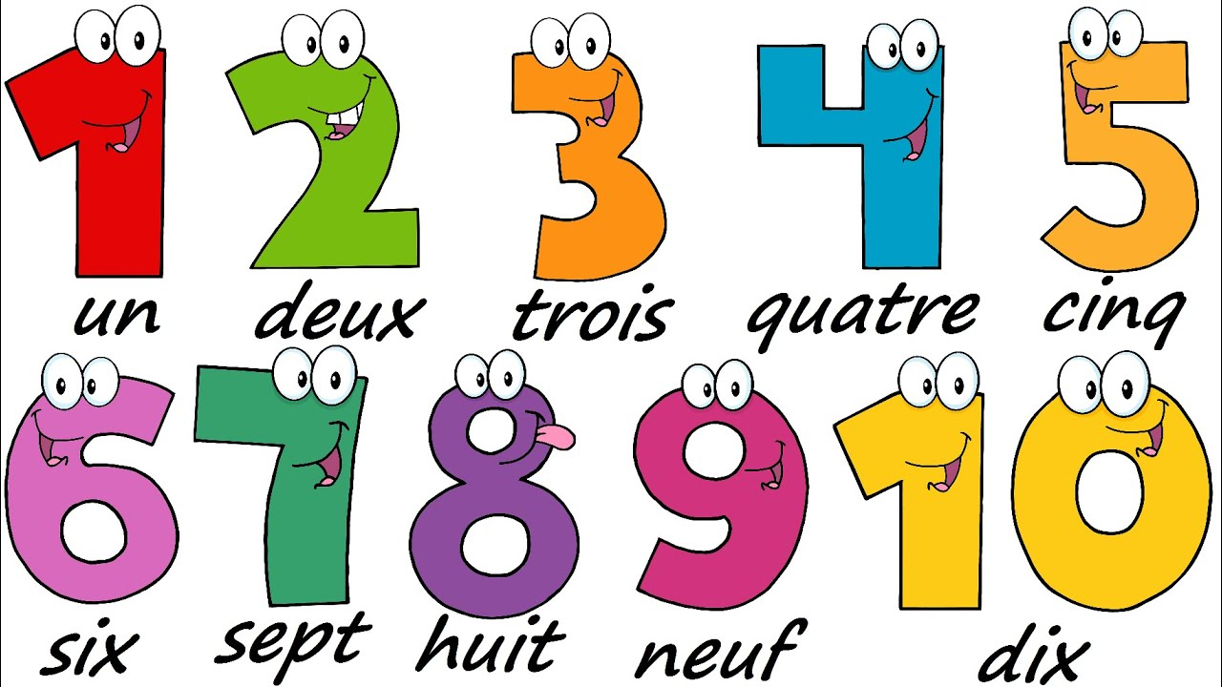
Counting in French
https://www.bbc.co.uk/bitesize/clips/zrdg9j6
Follow the link or type ‘numbers in French BBC bitesize’ into Google. Click on the above website.

Slide 3
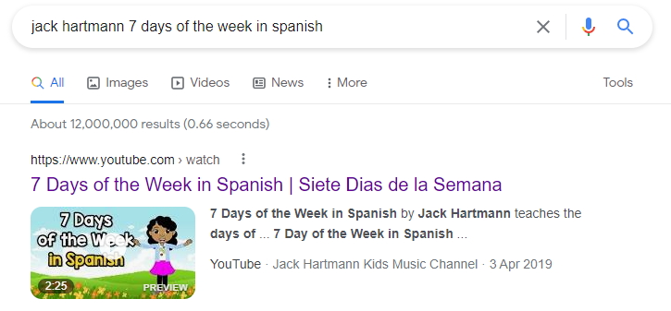
Days of the week in Spanish
https://www.youtube.com/watch?v=SQbspMMdJU8
Follow the link or type ‘Jack Hartmann 7 days of the week in Spanish’ into Google. Click on the above website.

